Slide 1
Libre Home Inc
Inevitable revolution in Smarthome/IoT World! Qingjun Wei Founder & CEO

Slide 2
Why Libre Home?
Current Systems
Crestron
Samsung / Xiaomi
Amazon / Google etc.
Billions Dollars Have Been Burn
Google’s $3.2 Billion Acquisition of Nest
They Simply Don’t Work
They can’t even blink a couple of light bulbs
They can’t even do right with a couple of dimmer switches
We Rebuilt Everything from Ground Up, and Fixed Everything They Failed

Slide 3
Blinking a Light
* Image is animated. Use “Slide Show” to view!
Final screenshot (right most) User setup steps (animated image)
Light Group #1
Turn light “Outdoor” on (level at 100%)
Wait for 1.000 second
Light Group #2
Turn light “Outdoor” off (level at 0%)
Wait for 1.000 second
Loop back to step 1
Infinite loop …

Slide 4
Why Blinking Lights? Who Cares?!
Here is why …
IoT is about interconnectivity and interaction
Interconnectivity and interaction between totally unrelated things
“Things” could be “anything” in the near future
If a so-called “smart” system can’t even blink a couple of light bulbs
How smart can it be claimed?
God knows what else it cannot do?!
Well, I know exactly what else those system cannot do!
That can be proved mathematically, with theoretical computer science!

Slide 5
Before We Continue – IoT Apps
Let’s first talk about Apps
Smartphones all depend on Apps
Android Phone
Google Play Store
iPhone
Apple App Store
Libre Home has Apps
IoT Apps
Libre Home App Store
Blinking Light is an App
“Holiday Light Show” is the name
End Users Setup the App
On their smartphones
Choose any smart lights they installed in their homes
Choose how to blink
Arbitrary patterns chosen by users
Developers Develop Apps
And share with the whole world
On Libre Home App Store

Slide 6
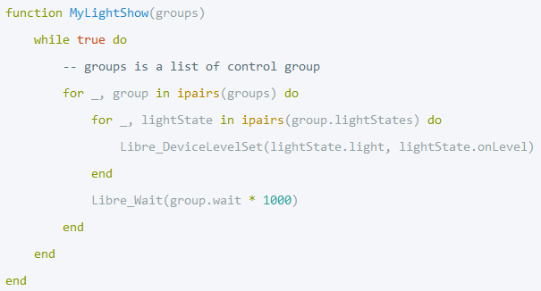
Libre Home IoT App
Clear Separation of the Roles
Developers
Develop Apps
Users
Use Apps
Users Never Have to Write Any Code
Free Development Tool
Light Show App
Only 10 lines of code
Infinite loop
Blinking any number of lights with any pattern

Slide 7
IoT App - Blinking Lights – Why Other Systems Can’t?
Other Systems
Basically event trigger and handler
Examples:
Detected people ⟹ Turn Light
Some state changes ⟹ Other state changes
So-called “ephemeral function”
Fire and die
Libre Home App Engine
Full fledged Operating System for IoT
Every App is a virtual process running on OS
A process is usually an infinite loop and may never die
Libre Home v.s. Others
“Virtual Processes” v.s. “Ephemeral functions”

Slide 8
IoT App - Theoretical Computer Science
Libre Home App Engine is Turing Complete
Other systems’ App Engines are not
Turing Complete
Equivariant to a Turing Machine
Can perform any algorithm
Can perform any possible automated control
Non-Turing Complete
There are unlimited algorithms that it cannot do
Blinking light a just one of them. There are many many more …

Slide 9
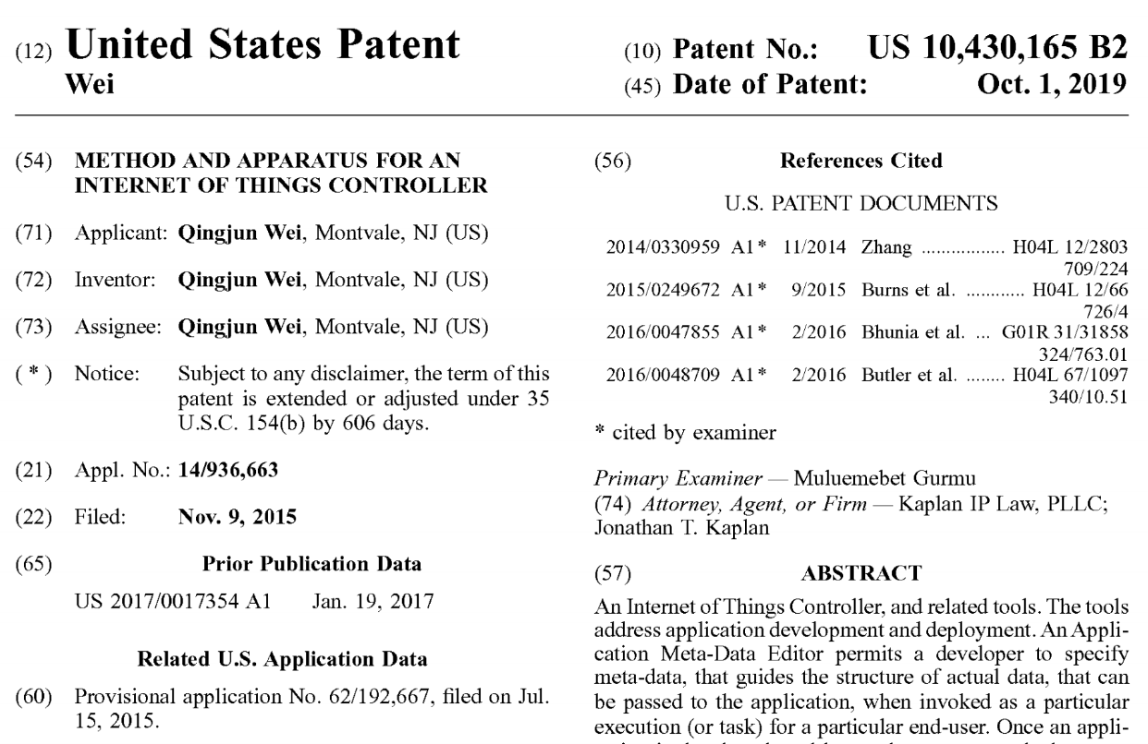
Patent – IoT App
One cannot patent Turing Completeness
It will be difficult to patent an Operating System
Even better, I patented the tree structure
It took USPTO 4 years to examine the patent
It has been examined twice
Once by examiner
Once by principle examiner
USPTO couldn’t even find any prior art
The patent was granted with 18 months extension

Slide 10
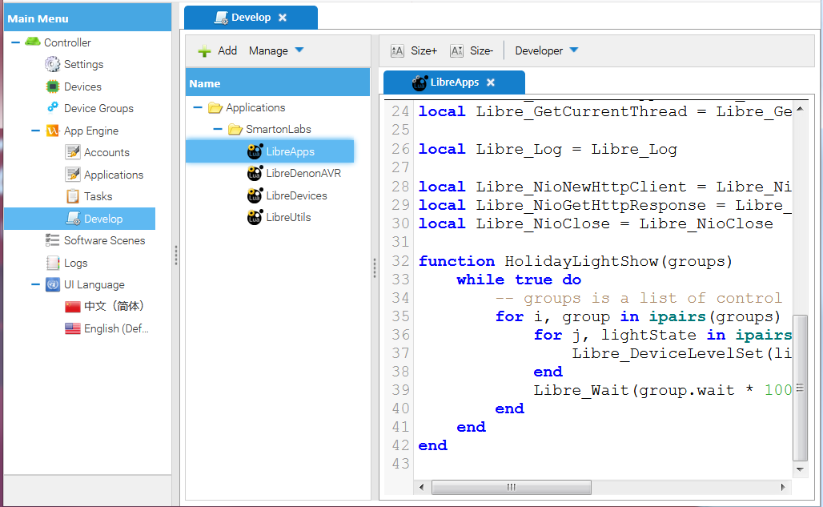
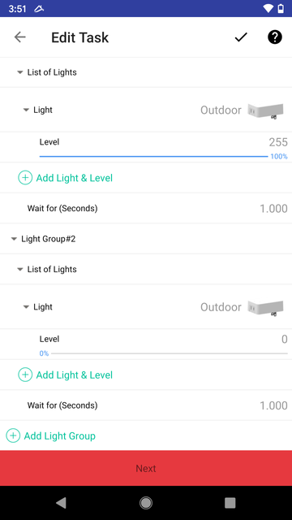
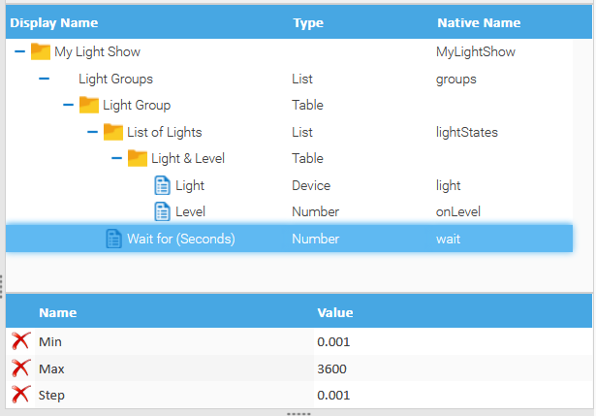
Patent – IoT App - How does it Work? Automated Generation of UI (e.g. Smartphones)
User
UI Automatically generated
It is another TREE!
On user’s Smartphone
Developer
Write Code
Specify Input Structure
It is a TREE!

Slide 11
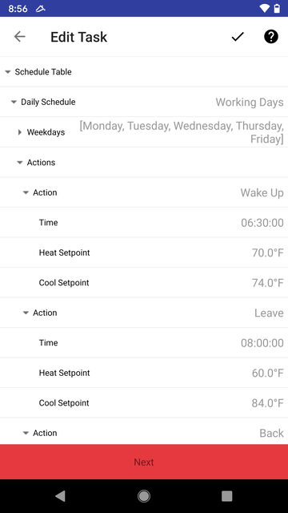
Patent – IoT App - Reinventing Tree Structure
This patent covers the end-user UI (User Interface)
It describes how a user of internet of things controller setup an App process
It covers any tree structure
Array of array, array of struct, struct of array, struct of struct
I reinvented the Tree Structure!

Slide 12
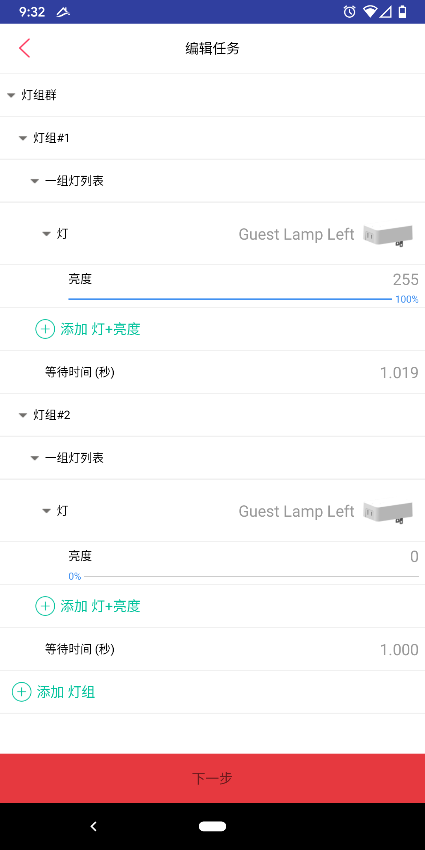
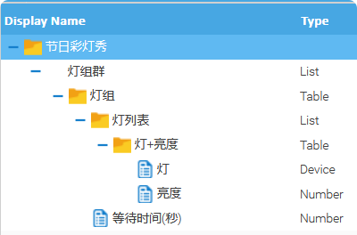
Another Patent – IoT App Can’t Get Enough from Tree Structures!
Here is another patent pending
This pending patent is about translation of UI
Anyone can contribute the translation of an App
And share with the whole world
Extra layer of protection of my intellectual property.

Slide 13
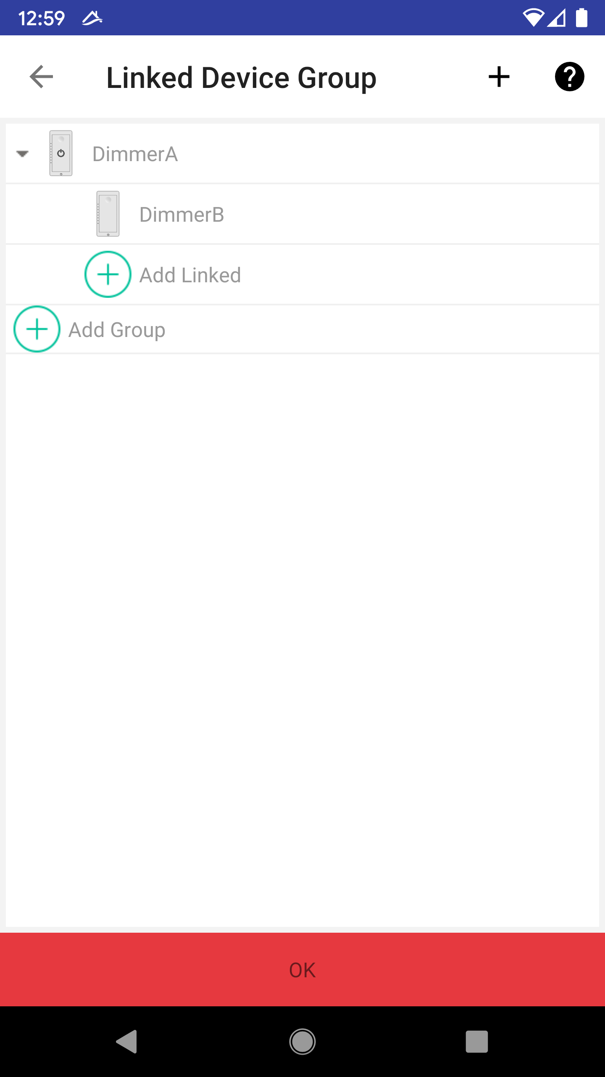
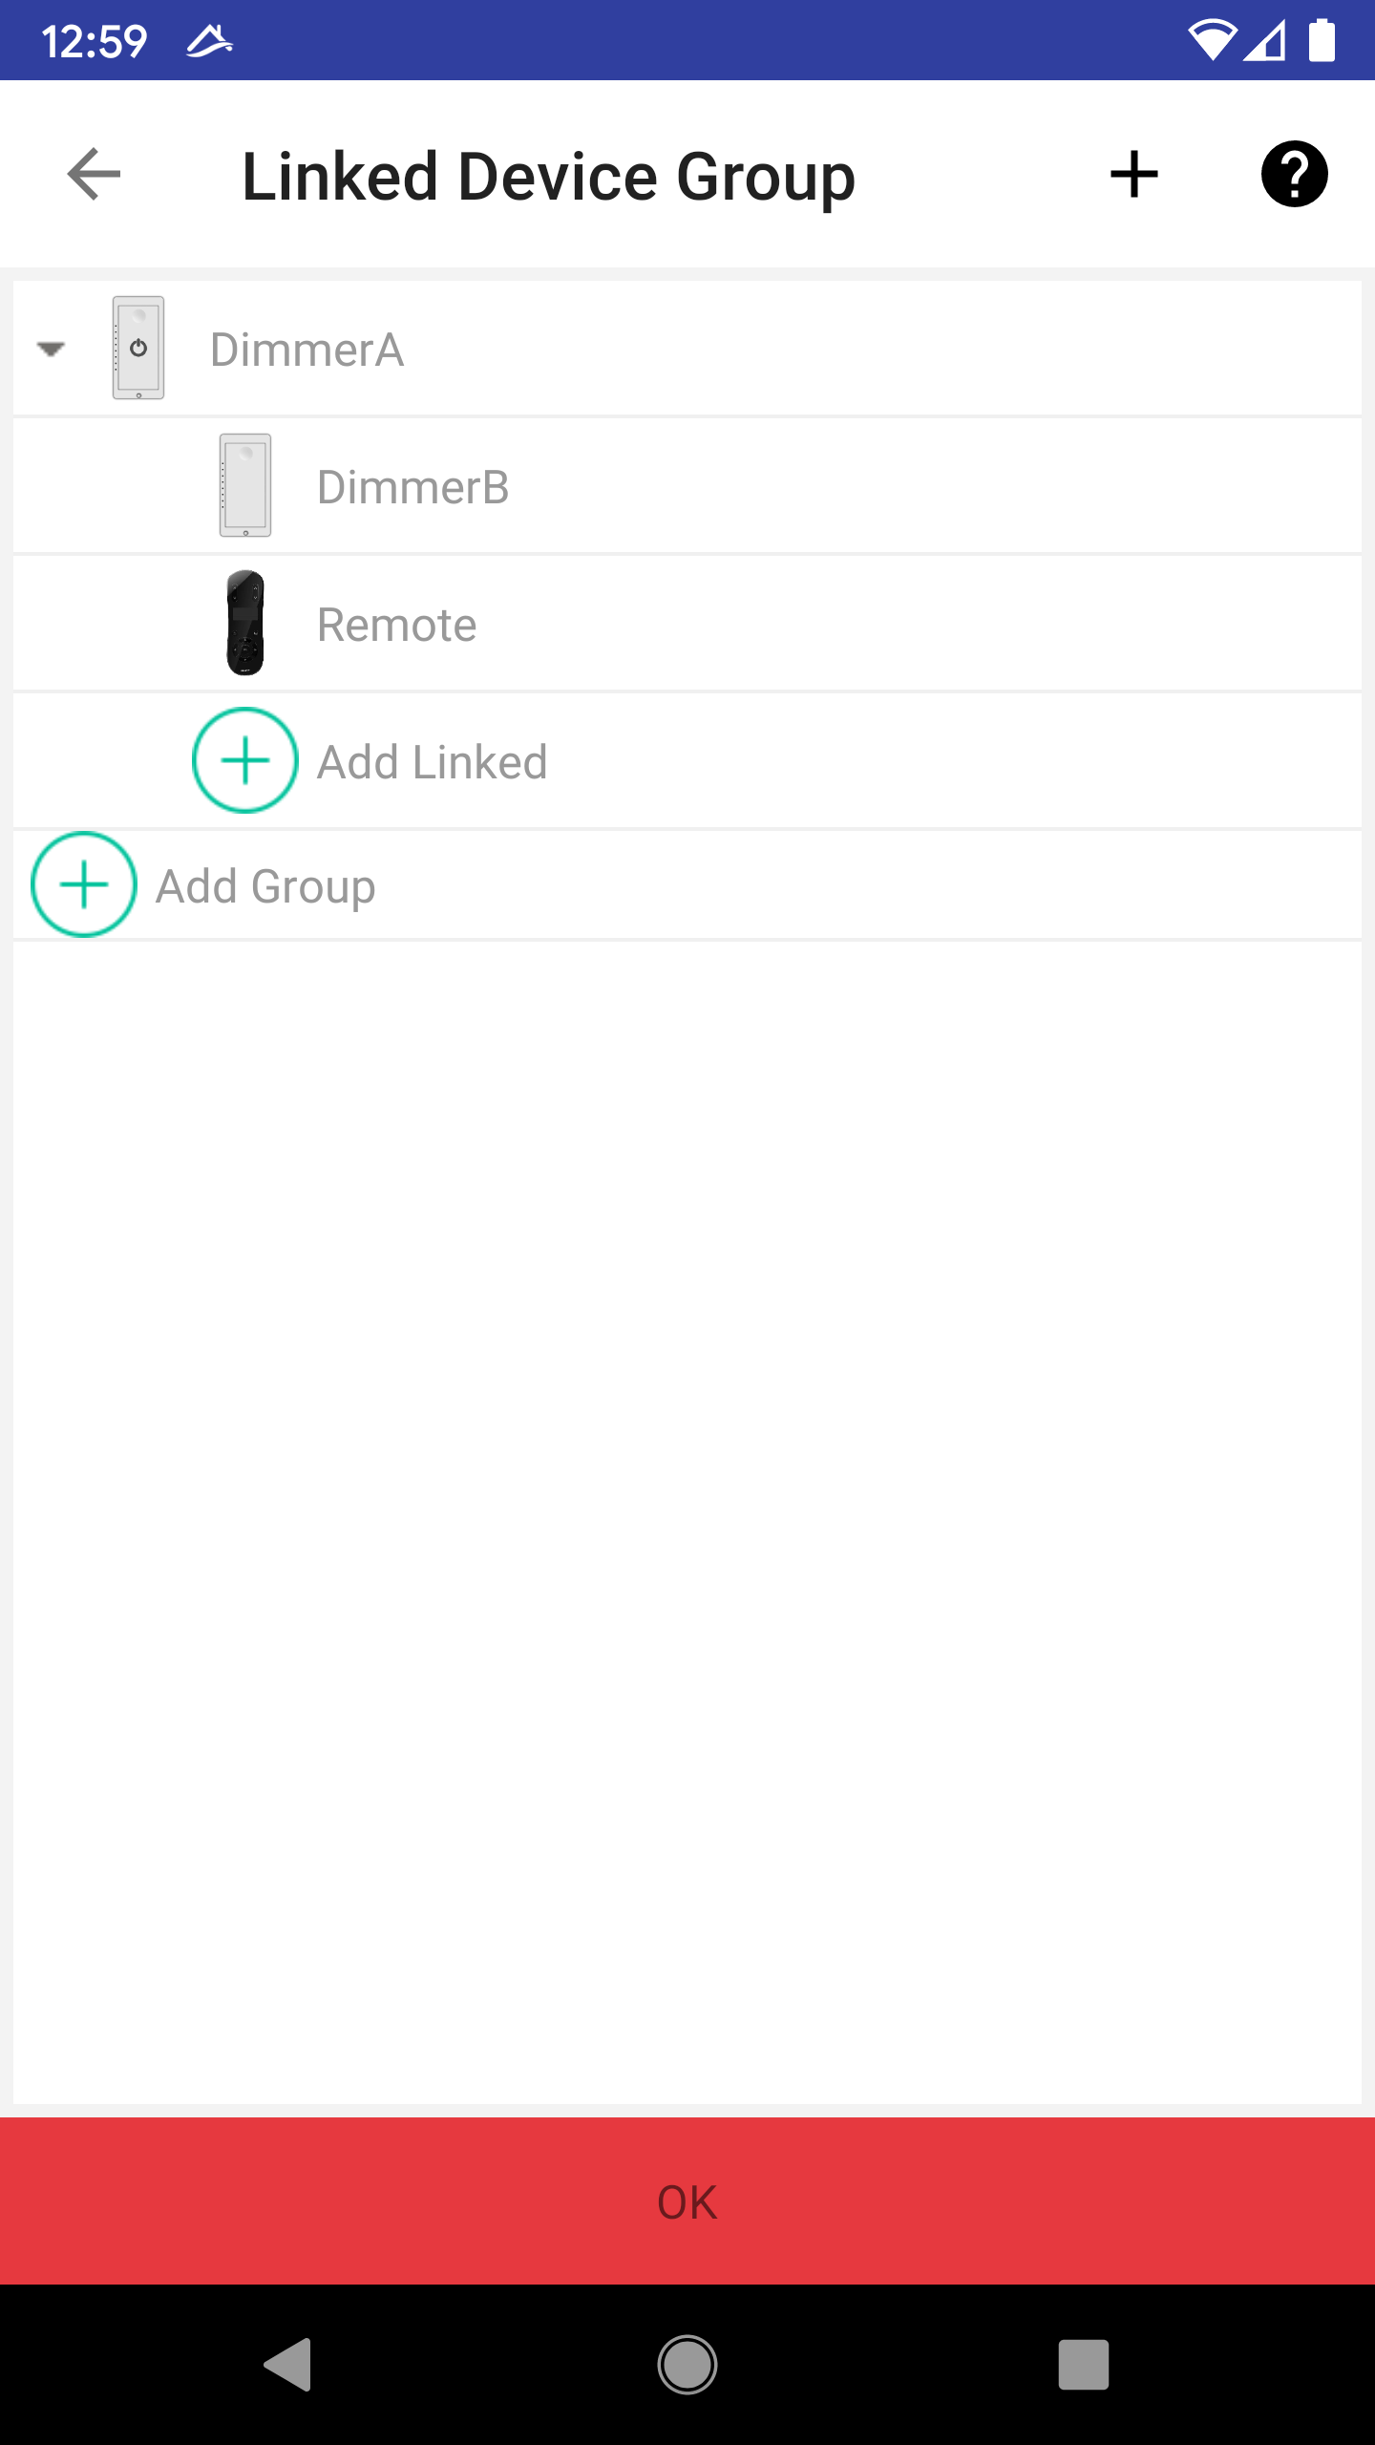
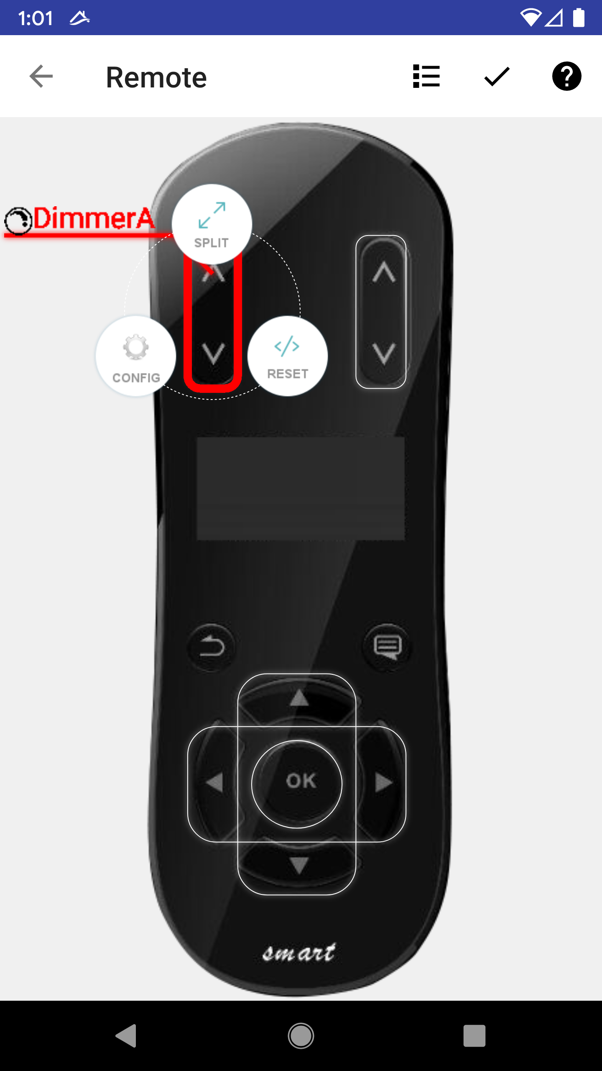
System - 3 Way Switch, and Beyond
Two (or more) switches control one light. Every American home has it.
In Libre Home, just link DimmerB to DimmerA. DimmerB will work as a remote control of DimmerA
Add a Remote? It is simple, just add the remote to list.
Now remote can also control DimmerA User can further customize which button.

Slide 14
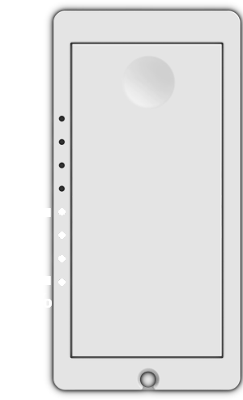
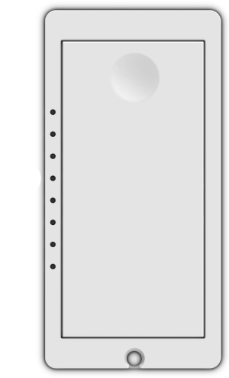
System - 3 Way Switch, Can Samsung & Xiaomi Really Do it?
We set DimmerB to control DimmerA
Now a user manually set DimmerA to 50% The level indicator shows 50%
What will the level indicator on DimmerB show? Good luck with Samsung or Xiaomi!

Slide 15
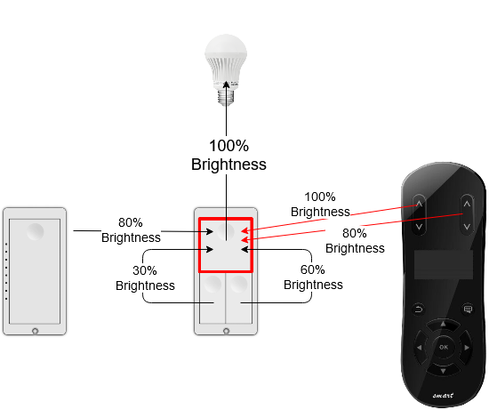
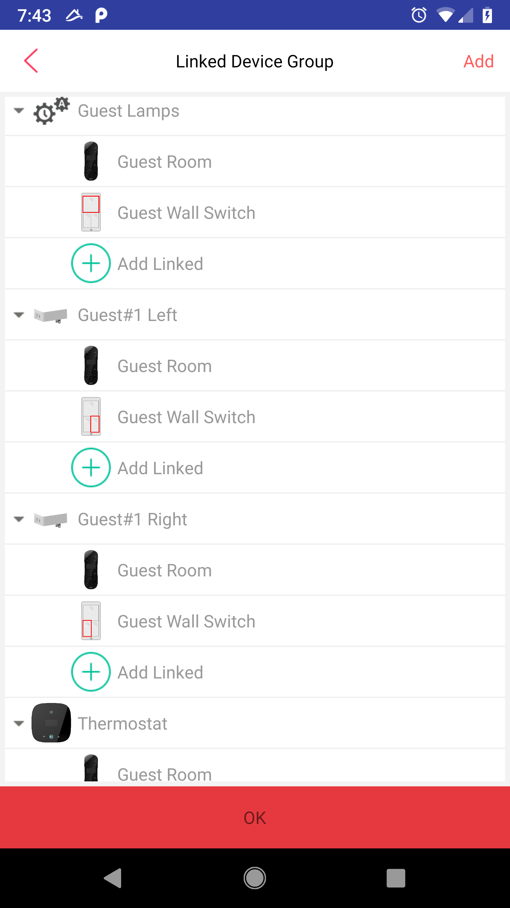
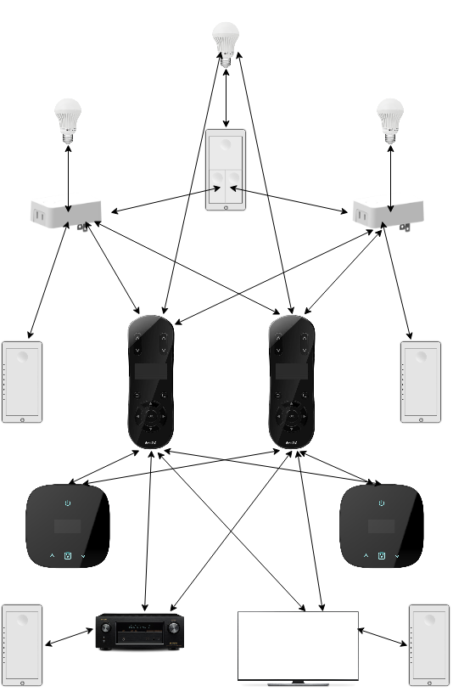
System - This is a Binary Business
It is either design to make every sense, or does NOT make any sense at all!
There are countless simple use cases, that only Libre Home can do!
Some of them are because we don’t have any logical design flaws while other systems have
Some of them will depend on our patented App Engine under the hood

Slide 16
What About Crestron
Crestron has 100s of engineers and 10,000s of contractors
They will build custom app for your home to satisfy any of your need
At the cost of $300 per hour per staff
Our patented App engine will crowd-source the whole world to write Apps
We even crowd-source whole world to translate Apps
It cuts down the customization cost to close to ZERO!

Slide 17
Cloud Based System
Samsung, Amazon, Google etc. are all cloud based
Massive privacy invasion! Sole purpose is to control users’ data, users’ life, while asking users to pay for it. We do not collect any users’ data! Zero data leak!
If your internet is down, you lose control. Wi-Fi light switch sends 10s of MB of data to cloud every day
Cloud based systemIt has to be light weighted, such as AWS Lambda or IFTTT
Hosting complex control is prohibitive
They can’t even blink two lights. There are unlimited things they can’t do!

Slide 18
Will Cloud Based System Ever Make Sense?
No! It will never make any sense, to end-users
It will become forever conflict interest between business and end-users
Is it any necessary? No! It is not!
Why not work on something inevitable?

Slide 19
What About Voice-Assistance?
It has become a commodity
It is much easier to build than a new Operating System for IoT
It is just an accessory for our system
On our patented App engine, one can write an App for Google/Amazon/Apple voice controls, so that users can use voice to control any device in our system
It will be several hundreds line of code. That’s it!
How about a privacy focused Voice Assistance?

Slide 20
Our Technology - Software
Patented IoT App Engine
Wireless Networking Technology
Everything is seriously flawed in this industry
We fixed Zigbee protocol
Unique encryption key for each pair of devices
Better routing and route management
Dynamic router/end-device switching
Video Technology
We Fixed Whatever the Industry Failed, in Every Layer

Slide 21
Our Technology - Hardware
So far 8 Devices
8 UL Certifications
Know-how about RF (Radio Frequency) Design
United States actually falling behind in this area
This is a sensitive topic
Our current product has 5 times wireless range of Xiaomi’s devices
Optimal AC/DC Design
Talk is Cheap. I Show You Products

Slide 22
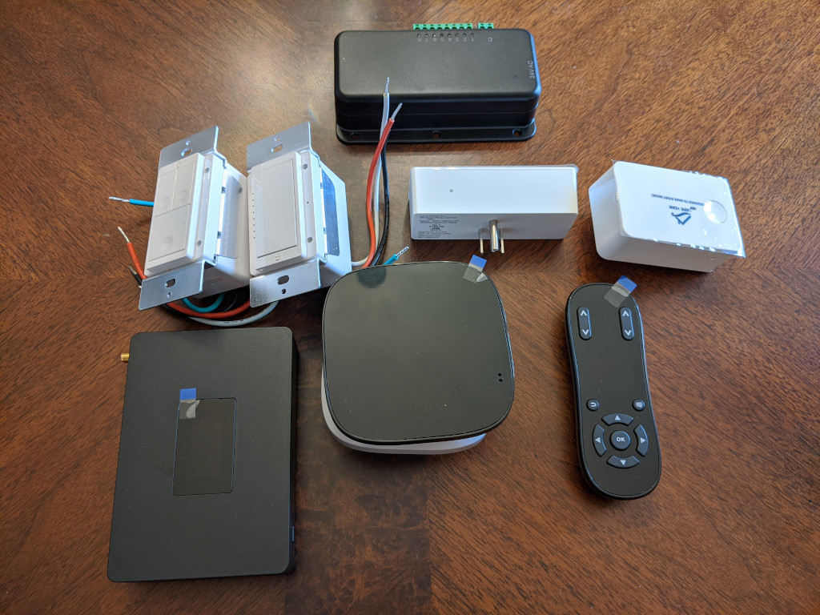
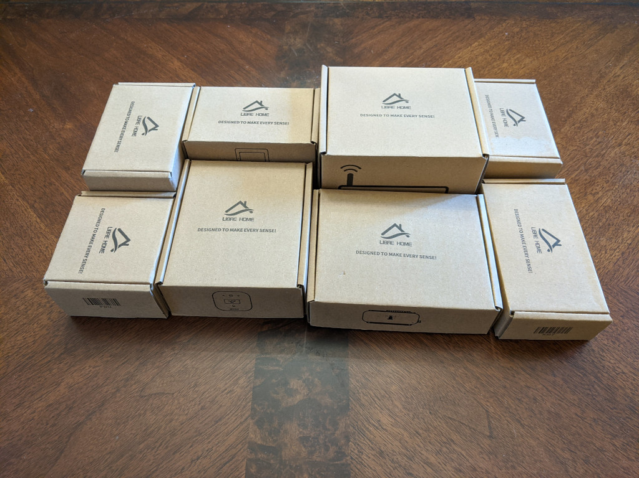
Current Products
Samples Available
Mature and Robust!
Welcome to Abuse!

Slide 23
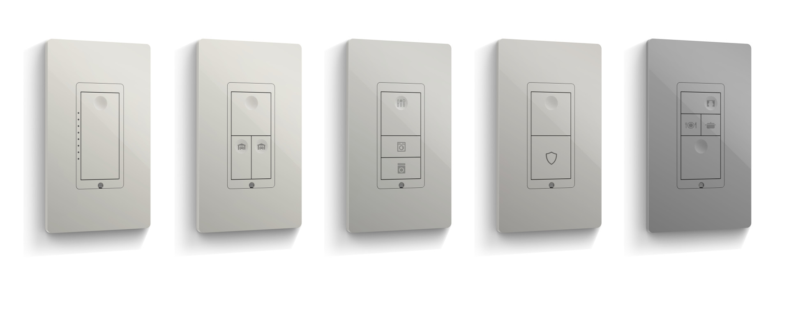
In-Wall Switches – My Unique Design!
Customizable Color, Layout, Laser Mark. Classic Beauty, with a Modern Touch!

Slide 24
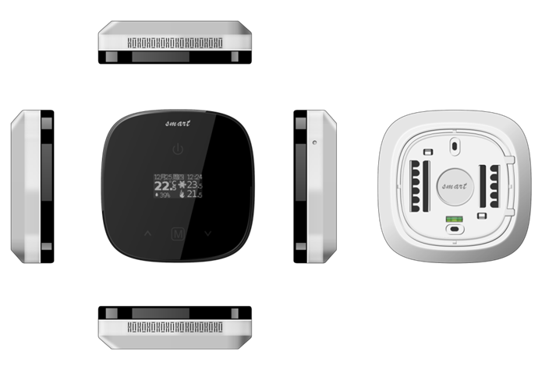
Thermostat – Low Cost & Smarter
Cost $20 to build
Nest is just an App in Libre Home
Our App can be much smarter, with more data integrated from the whole house
And it will be 100% private with Zero Data Leak!
App will be open sourced! Let the whole world work on it! Let it evolve!

Slide 25
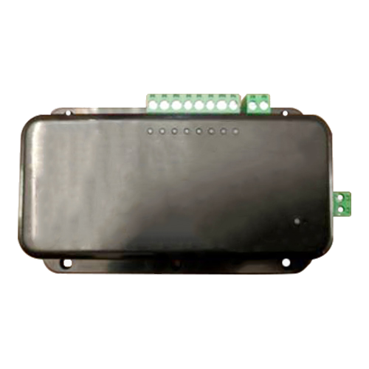
Sprinkler Control
Costs less than $20
Works with out patented App technology
Weather forecast, future sensors support
We open source the App
Let it evolve forever

Slide 26
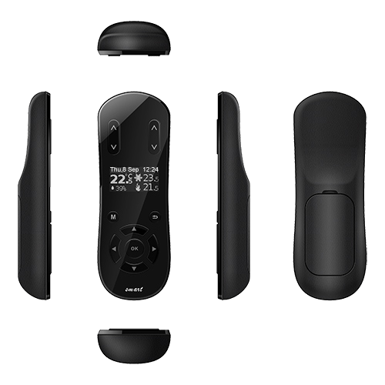
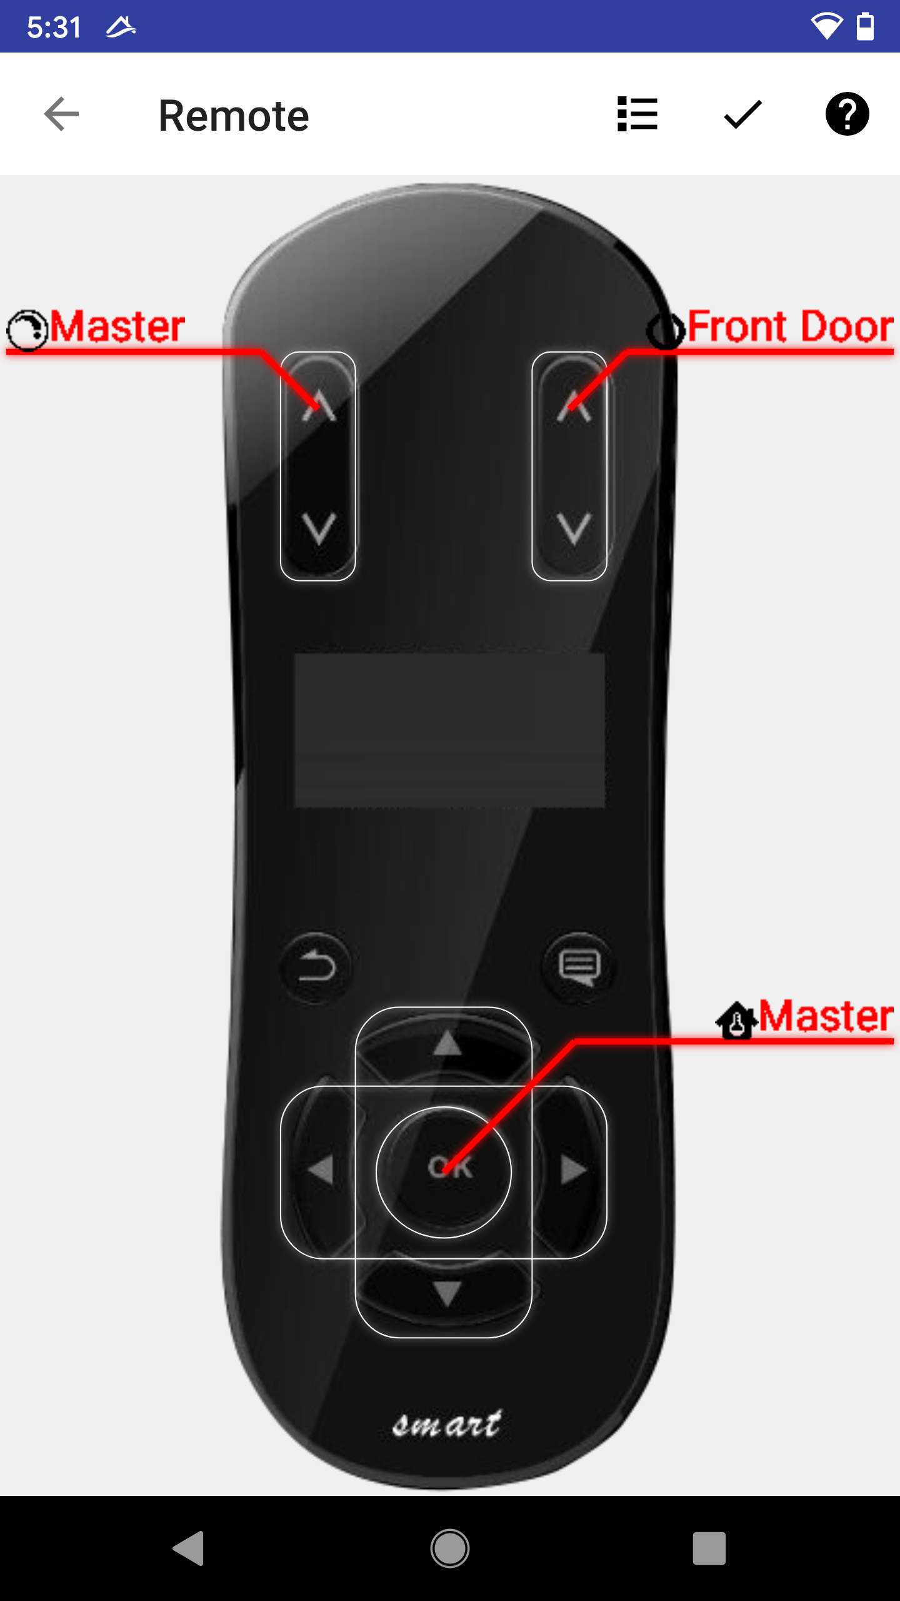
Libre Home Smart Remote
2 X AAA Batteries Lasts 2 Years
A Perfect Example of Our Low Power Wireless Technology
It is a Platform by Itself! Thanks to our design and patented App Engine.
It offers ultimate customization capability

Slide 27
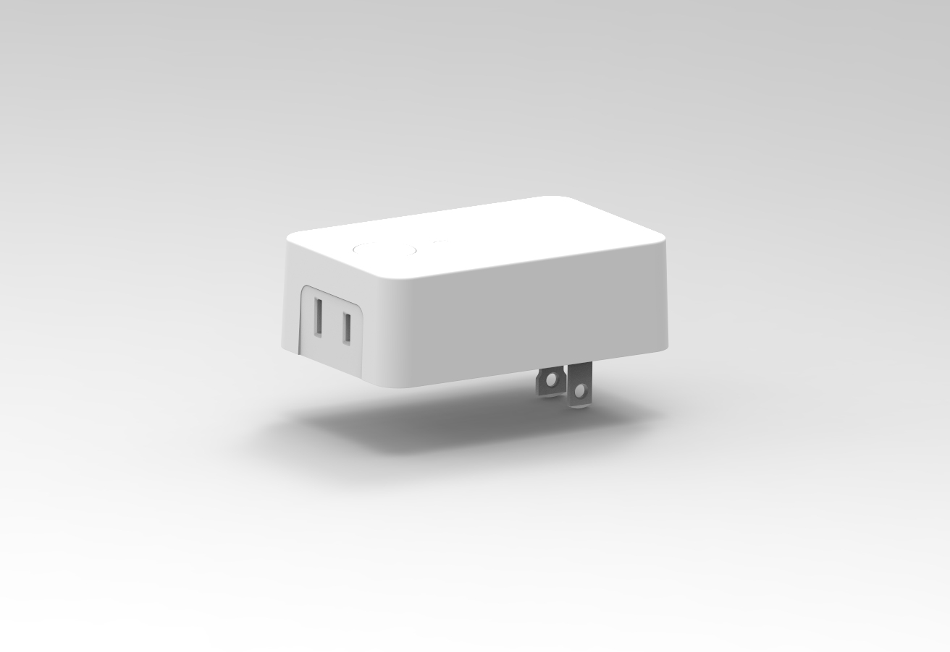
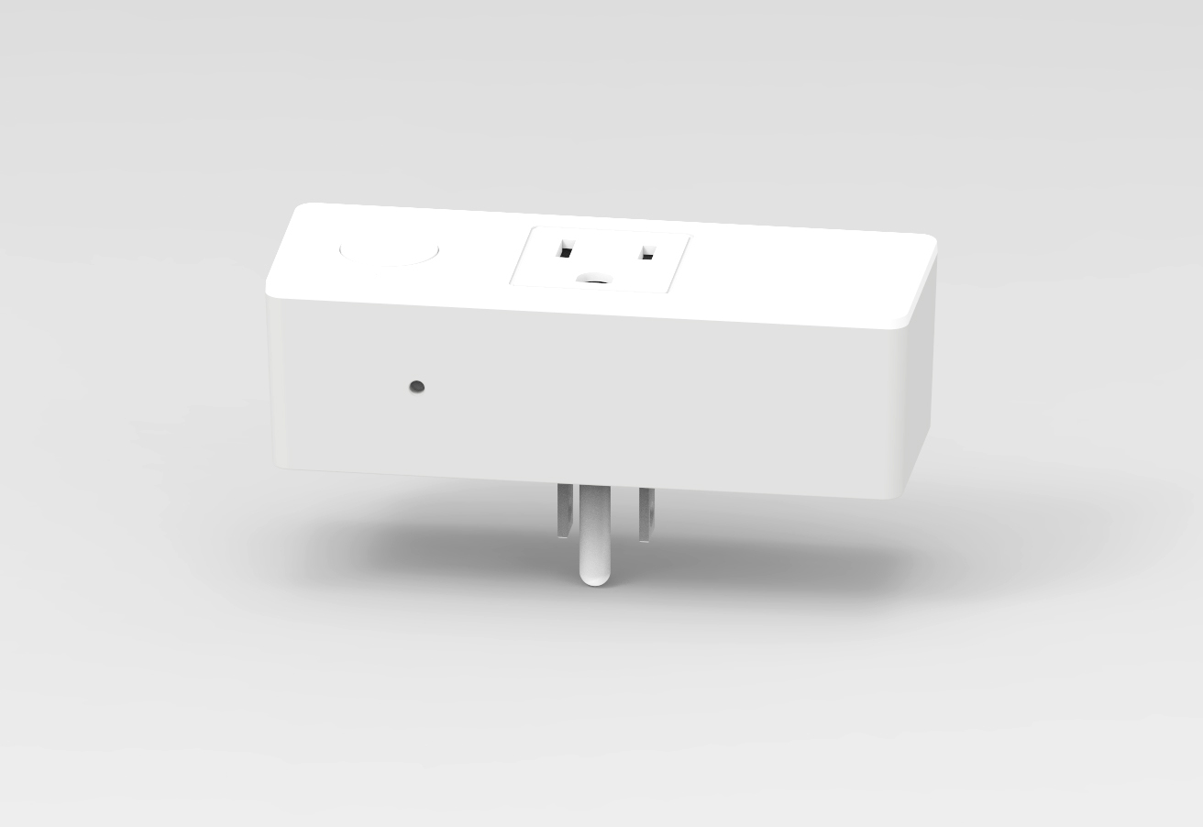
Plugin Relay and Dimmer
Next generation software will extend our patented technology to every individual device
Each device will be able to host the same virtual machine as Hub
It will bring any sophisticated control to every device with orders of magnitude of reliability!

Slide 28
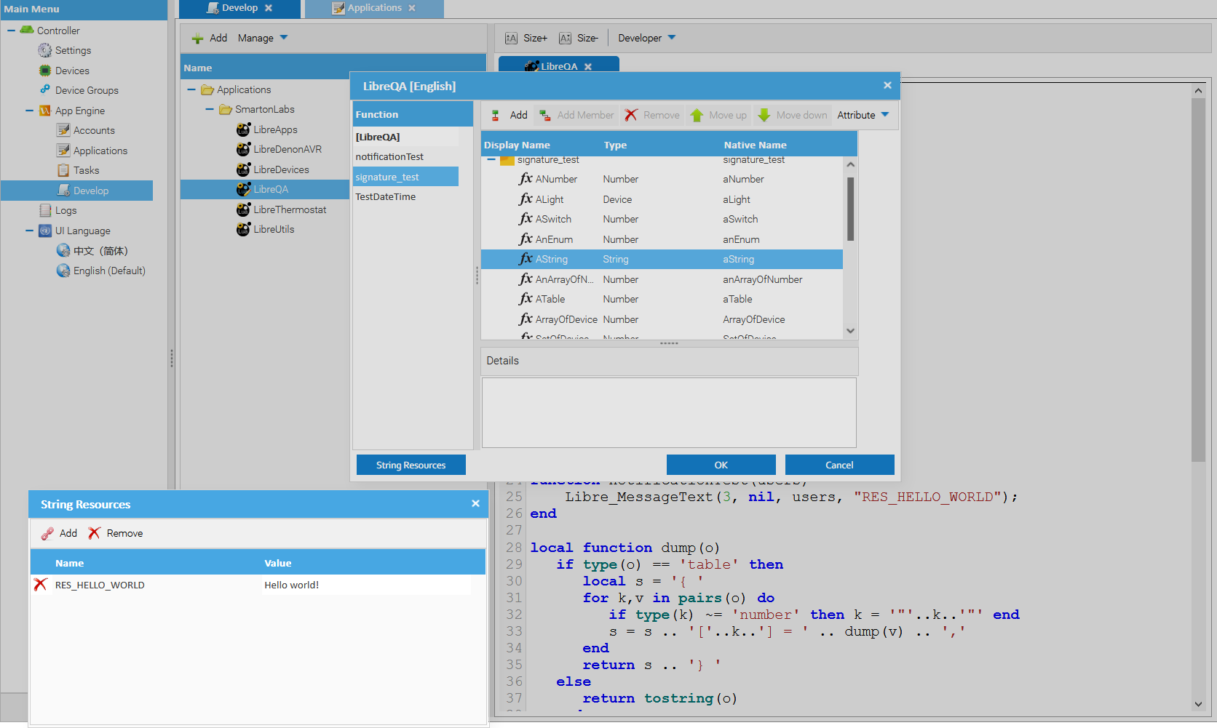
Development Tool, IDE/Debug/Deployment

Slide 29
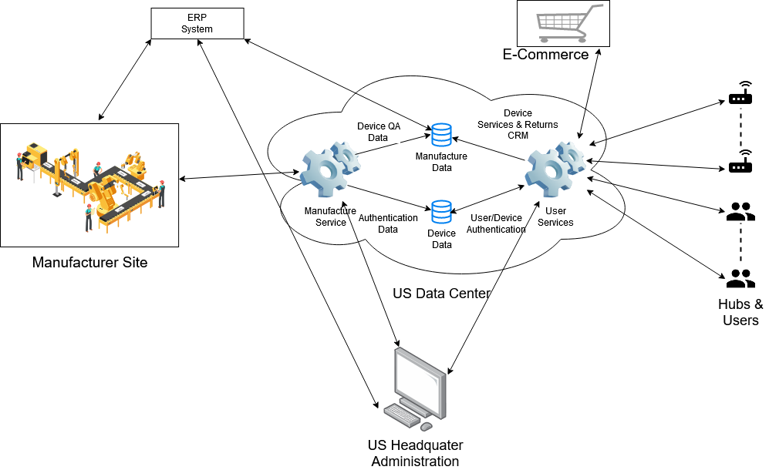
Entire Business is Industrial IoT ERP/CRM Data Flow with Strict Access Control

Slide 30
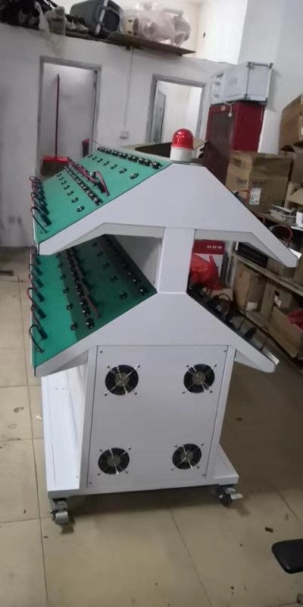
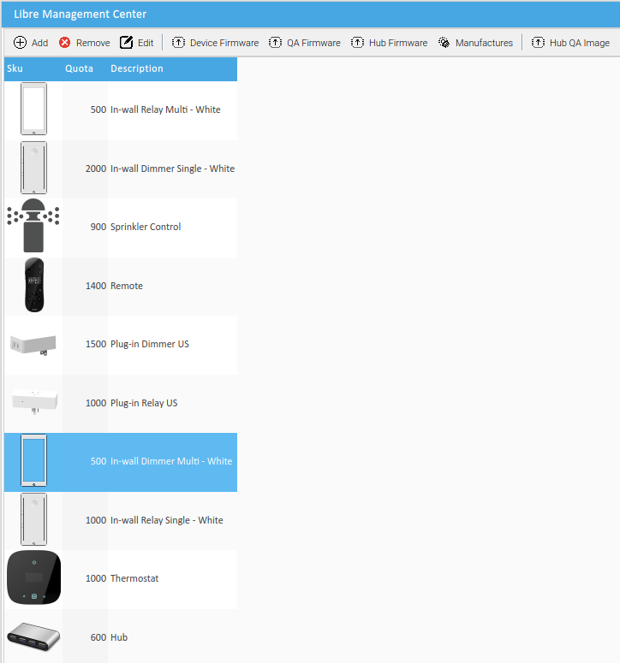
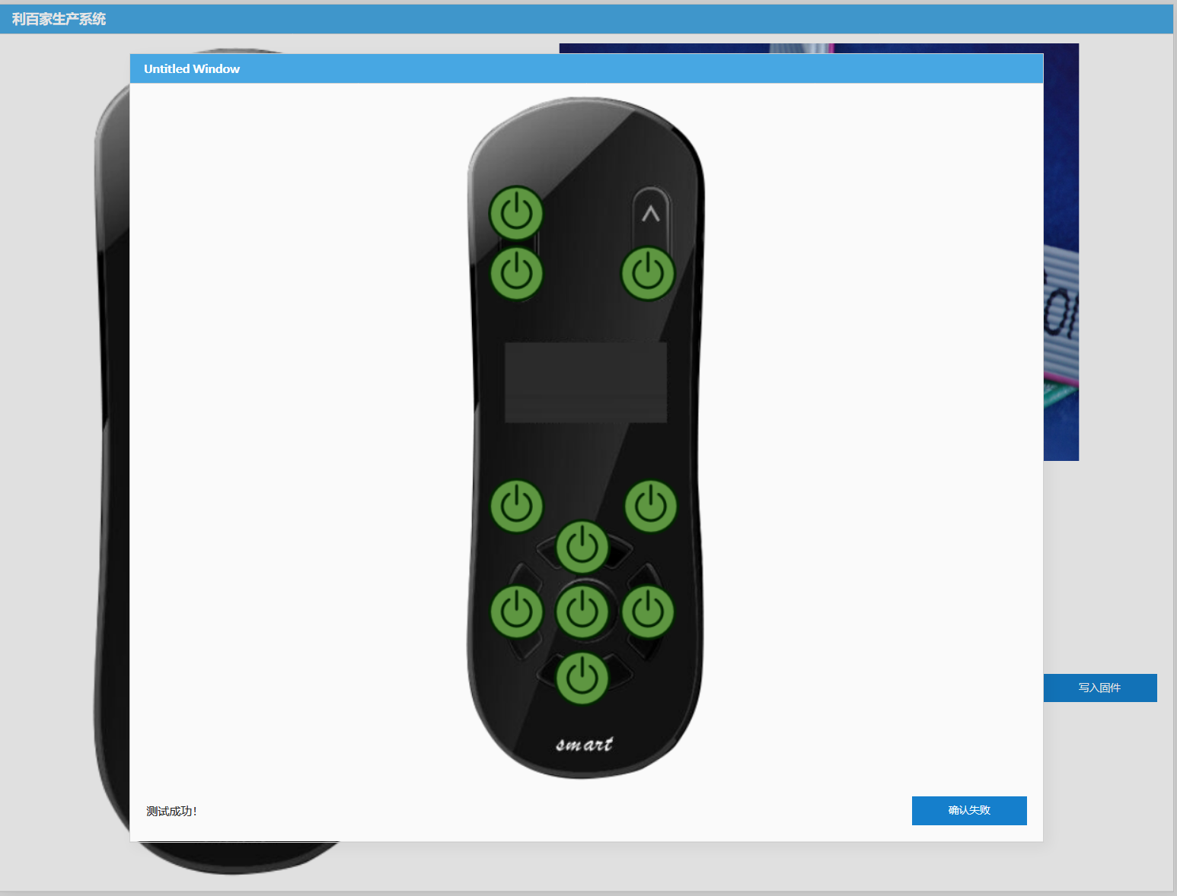
Manufacture/QA Tooling, Software and Firmware
In-house built, full fledged manufacture management, custom tooling, QA software and firmware.

Slide 31
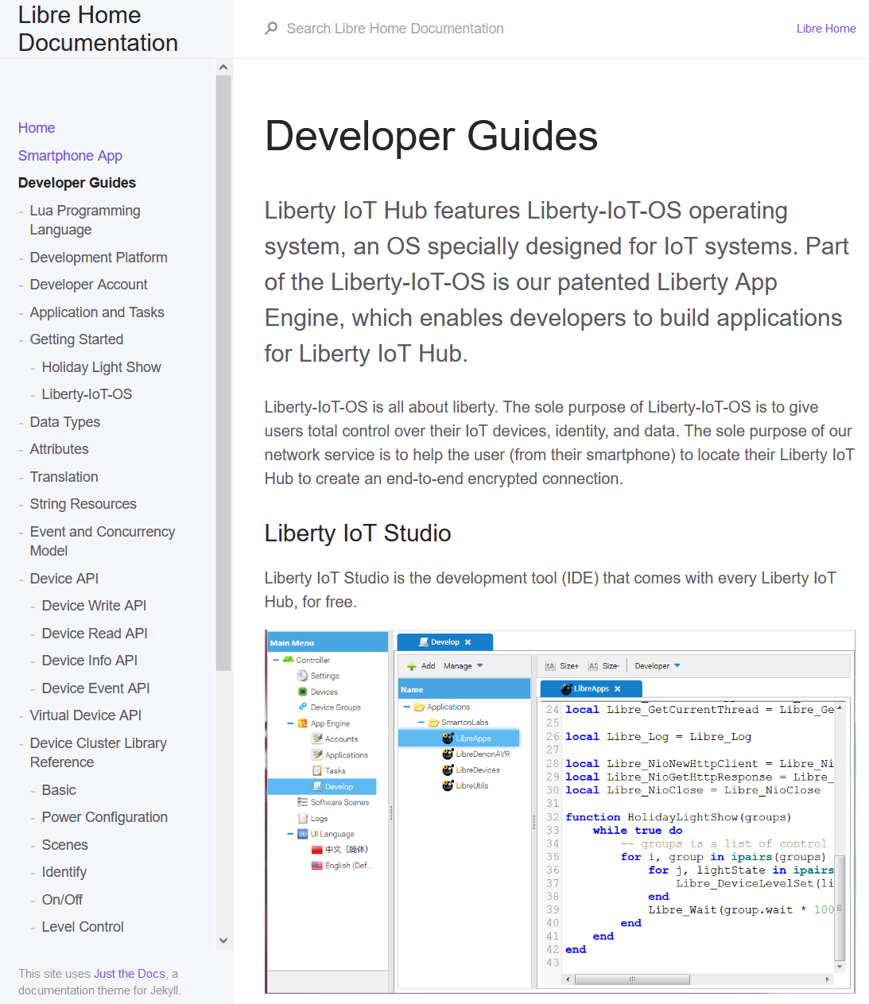
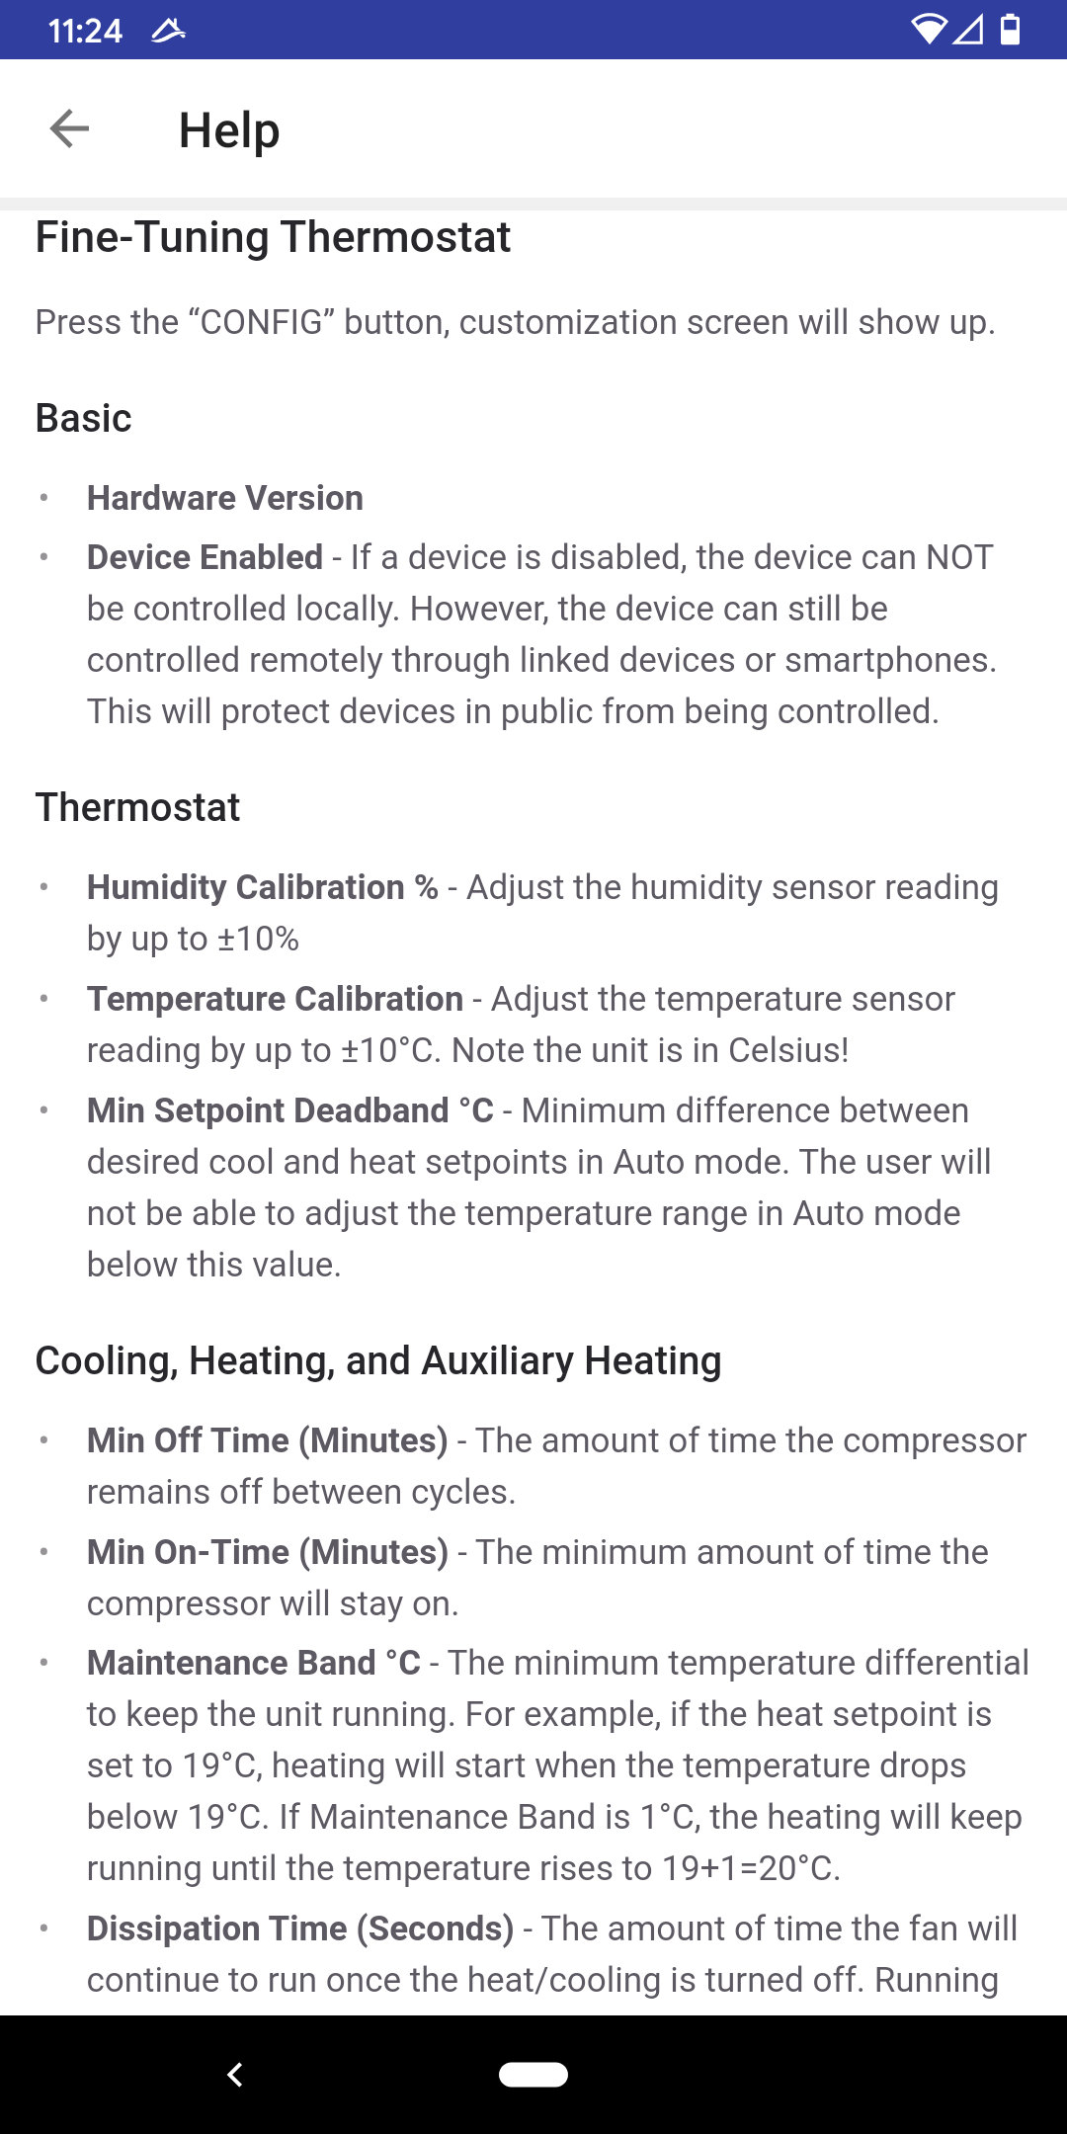
Full Developer/User Documentation
Actively maintained, constantly updated tutorials and API document
Context sensitive help from user’s smartphone. Get help whenever you need it, help that really helps!

Slide 32
Market Analysis
It hasn’t taken off yet
Most likely every home will install it within 20 years
It will be a relatively slow process
But it will be a sustainable business in the next decades
Which is perfect for a start-up company
We know current systems don’t work, don’t make sense
We can be everything they are not, and establish, and prosper!

Slide 33
Just Imagine
All Those Cloud-Based Providers are Touting their Trillion IoT Devices Capacity
All Those RF Chip Makers are Prepared for Billions of Chips Per Year
Everybody Wants to Sell it to Somebody
Our Products Makes Differences in Every Perspective!

Slide 34
Our Business Model
We will be privacy focused and security focused
We will promise Zero data leak! No one else can make such promise!
We will also offer our own hardware
We start from several “key devices”,
Hub, Lighting control (switches/dimmers), Thermostat, remote, sprinkler control
We expand our product line
Users pay license fee for each third party device connect to our Hub!
Make sure they gradually switch to our hardware

Slide 35
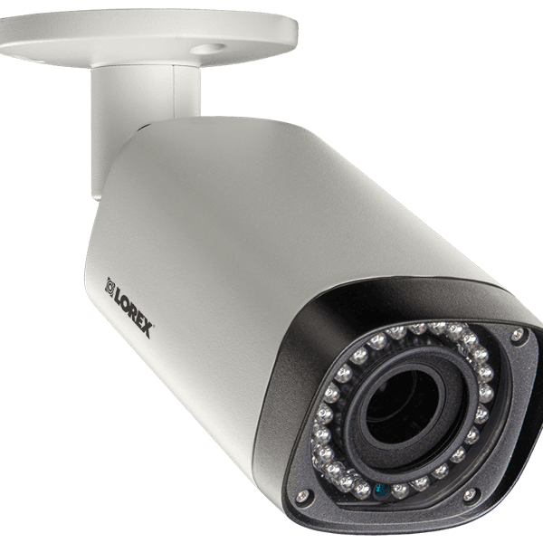
Our Business Model
Secure All IP Cameras in American Homes
Automatically Detect 100s of IP Cameras
Monitoring IP cameras from Smartphones
Build Our Own Advanced Video Technology and Security Cameras
Think about Zoom Technology
Think about Wyze Cameras
What about DVR Business? And Storage Devices/Services?

Slide 36
Know Your Customers
Those Who Buy $5 “Smart Wi-fi Switches” from Amazon
Are NOT our Customer
We will Technically and Strategically Avoid that Kind of Customers
Still That Leaves Enough Customers Who Has The Demand and Understands Our Differences or Our Value System
And They will Have No Other Choices but Us!

Slide 37
The Company
Basically Solely Founded by Mr. Wei and His Family
United States
Smartonlabs Inc IP holding entity, core System R&D
Libre Home Inc Brand name, store front
China
Smartonlabs Shenzhen Hardware R&D, manufacture
Smartonlabs Harbin Smartphone UI & graphic design

Slide 38
Raising Capital
All software can be taken granted
We still need to expand the team, but cost and risk are beyond manageable
Hardware, supply chain and manufacture
We won’t be a great company if we can’t control the supply chain
Marketing team
What about US – China tension?
It represents challenge, and opportunity as well
Our whole business is about balance and a sustainable society
From privacy-focus to diversification of supply chain

Slide 39
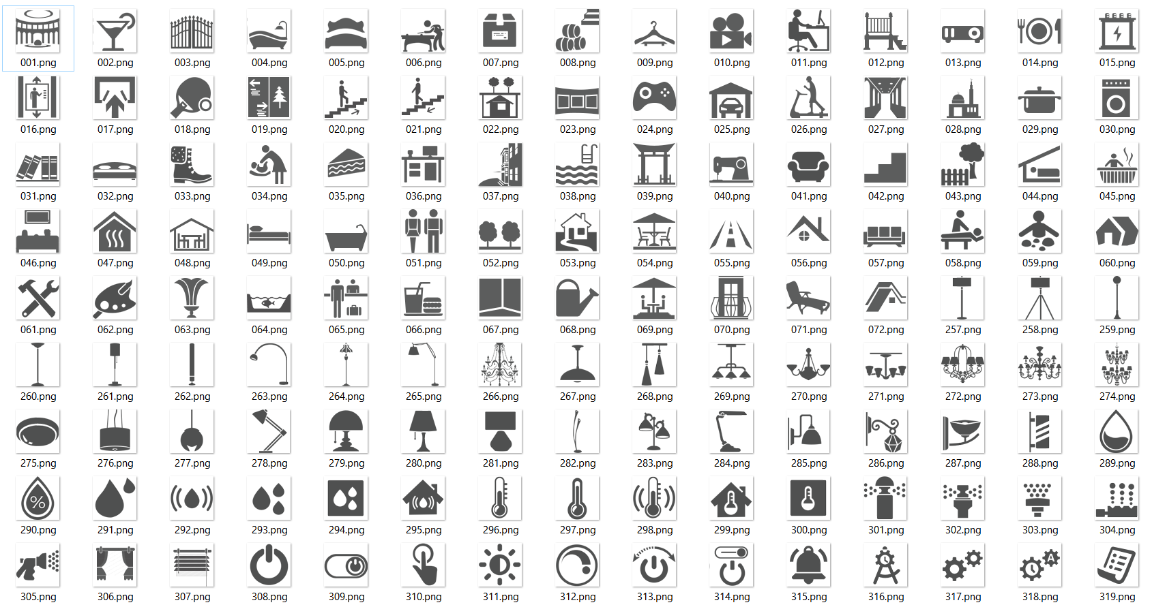
Thank You

